Slide 1

BU90004GWZ-E2EVK-101 Measurement Report
March 13th, 2014
Hosted by: Xuan Dang

Slide 2
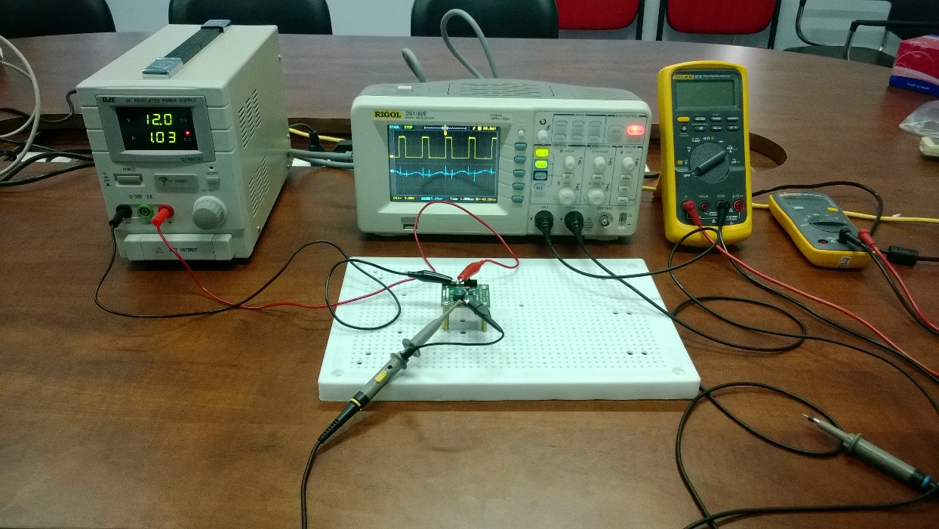
Equipment list
Regulated DC Power Supply
QJE QJ3005XE (0-30V/5A)
Multimeter:
Fluke 87V True RMS
Fluke 106
Oscilloscope
Rigol DS1102E
Electronic Load
B&K BK8500
Current probe
RP1001C

Slide 3
Functional Test
Test case 1 procedure
Connect DC Supply to: [+]V_{IN}(TP1) and [-]GND(TP2) when EN is off. Set output of DC Supply in range from 2.3V to 5.5V and turn it on.
Connect Electronic Load to: [+]V_{OUT}(TP3) and [-]GND(TP4). Power on Electronic Load, set input of Electronic Load to 1A and turn on load.
Move J1 header to turn EN on.
Result:
V_{IN} = 2.3V ~ 5.5V
I_{OUT} = 1A
V_{OUT} = 1.69V ~ 1.80V (in both modes, Automatic PFM/PWM and Automatic PFM/PWM). Test passed.

Slide 4
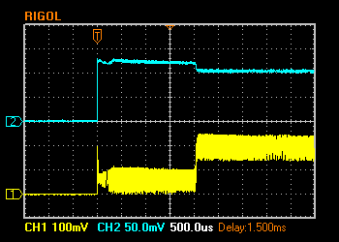
Functional Test (cont.)
Test case 2 procedure
After implement test case 1, the IC operate properly.
Move J1 header to turn EN off.
Move J1 header to turn EN on.
Result:
V_{IN} = 5V.
V_{OUT} = 0.21V/1A (in both modes, Automatic PFM/PWM and Automatic PFM/PWM). Test failed.
I_{OUT} 0.5A/Div. (DC)
V_{OUT} 100mV/Div. (DC)

Slide 5
Functional Test (cont.)
Test case 3 procedure
After implement test case 1, the IC operate properly.
Turn off DC Supply.
Turn off load( don’t power off Electronic Load).
Move J1 header to turn EN off.
Turn on load.
Turn on DC Supply.
Move J1 header to turn EN on.
Result:
V_{IN} = 5V.
V_{OUT} = 0.21V/1A (in both modes, Automatic PFM/PWM and Automatic PFM/PWM). Test failed.
I_{OUT} 0.5A/Div. (DC)
V_{OUT} 100mV/Div. (DC)

Slide 6
Functional Test (cont.)
Test case 4 procedure
Connect DC Supply to: [+]V_{IN}(TP1) and [-]GND(TP2) when EN is off. Set output of DC Supply in range from 2.3V to 5.5V and turn it on.
Connect Electronic Load to: [+]V_{OUT}(TP3) and [-]GND(TP4). Set input of Electronic Load to 1A and don’t turn on load.
Move J1 header to turn EN on when load is still off.
Turn on load.
Result:
V_{IN} = 2.3V ~ 5.5V
I_{OUT} = 1A
V_{OUT} = 1.69V ~ 1.80V (in both modes, Automatic PFM/PWM and Automatic PFM/PWM). Test passed.

Slide 7
Functional Test (cont.)
Test case 5 procedure
After implement test case 1, the IC operate properly.
Turn off load.
Turn on load.
Result:
V_{IN} = 2.3V ~ 5.5V
I_{OUT} = 1A
V_{OUT} = 1.69V ~ 1.80V (in both modes, Automatic PFM/PWM and Automatic PFM/PWM). Test passed.

Slide 8
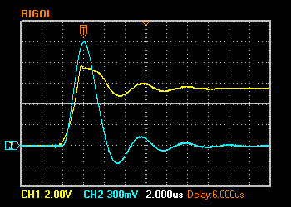
Hot Plugging Test
Test condition
V_{IN} = 5.5V
I_{OUT} = 1A
With original diode D1: P4SMA6.8A
Result:
I_{IN_PEAK}= 15A
V_{IN} peak transient voltage (in both modes) is 7.68V > V_{IN} Maximum Rating (7V)
The IC still operate properly after 100+ testing time.
V_{IN} 2V/Div. (DC)
I_{IN} 3A/Div. (AC)

Slide 9
Circuit Quiescent Current Measurement
Test condition
V_{IN} = 0-5.5V
Automatic PFM/PWM Mode
Room temperature 25ºC

Slide 10
Circuit Quiescent Current Measurement (cont.)
Test condition
V_{IN} = 0-5.5V
Forced PWM Mode
Room temperature 25ºC

Slide 11
Efficiency Measurements
Test condition
V_{IN} = 5V
V_{OUT} = 1.8V
Room temperature 25ºC

Slide 12
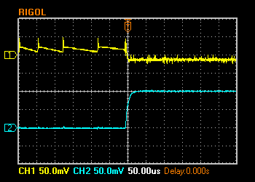
Load Response Measurements
Load response characteristic
(V_{IN}=5V, V_{OUT}=1.8V, I_{OUT}=0 → 1A, Automatic PFM/PWM Mode)
V_{OUT} 50mV/Div. (AC)
I_{OUT} 0.5A/Div. (DC)

Slide 13
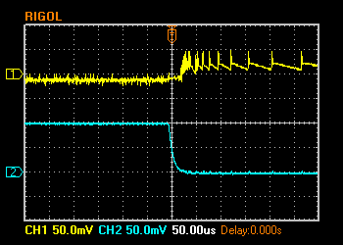
Load Response Measurements (cont.)
Load response characteristic
(V_{IN}=5V, V_{OUT}=1.8V, I_{OUT}=1A → 0, Automatic PFM/PWM Mode)
V_{OUT} 50mV/Div. (AC)
I_{OUT} 0.5A/Div. (DC)

Slide 14
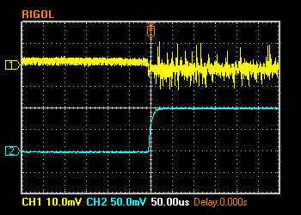
Load Response Measurements (cont.)
Load response characteristic
(V_{IN}=5V, V_{OUT}=1.8V, I_{OUT}=0 → 1A, Forced PWM Mode)
V_{OUT} 10mV/Div. (AC)
I_{OUT} 0.5A/Div. (DC)

Slide 15
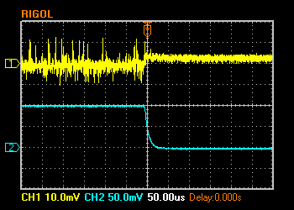
Load Response Measurements (cont.)
Load response characteristic
(V_{IN}=5V, V_{OUT}=1.8V, I_{OUT}=1A → 0, Forced PWM Mode)
V_{OUT} 10mV/Div. (AC)
I_{OUT} 0.5A/Div. (DC)

Slide 16
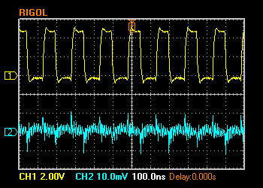
Ripple Response Measurements
V_{OUT} Ripple voltage
(V_{IN}=5V, V_{OUT}=1.8V, I_{OUT}=1A, Automatic PFM/PWM Mode and Forced PWM Mode)
V_{SW} 2V/Div. (DC)
V_{OUT} 10mV/Div. (AC)

Slide 17
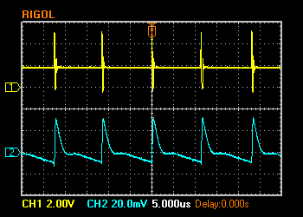
Ripple Response Measurements (cont.)
V_{OUT} Ripple voltage
(V_{IN}=5V, V_{OUT}=1.8V, I_{OUT}=10mA, Automatic PFM/PWM Mode)
V_{SW} 2V/Div. (DC)
V_{OUT} 20mV/Div. (AC)

Slide 18
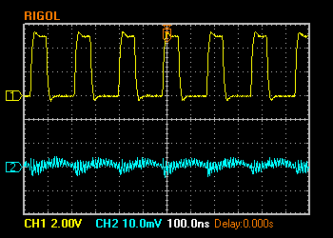
Ripple Response Measurements (cont.)
V_{OUT} Ripple voltage
(V_{IN}=5V, V_{OUT}=1.8V, I_{OUT}=10mA, Forced PWM Mode)
V_{SW} 2V/Div. (DC)
V_{OUT} 10mV/Div. (AC)

Slide 19
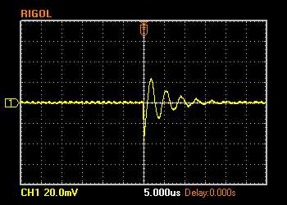
Input Voltage Ripple Measurements
V_{IN} Ripple voltage
(V_{IN}=5V, V_{OUT}=1.8V, C_{IN}=4.7uF + 0.1uF, I_{OUT}=0A, Automatic PFM/PWM Mode)
V_{IN} 20mV/Div. (AC)

Slide 20
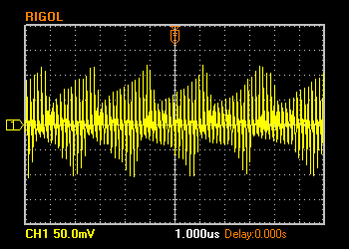
Input Voltage Ripple Measurements (cont.)
V_{IN} Ripple voltage
(V_{IN}=5V, V_{OUT}=1.8V, C_{IN}=4.7uF + 0.1uF, I_{OUT}=1A, Automatic PFM/PWM Mode)
V_{IN} 50mV/Div. (AC)

Slide 21
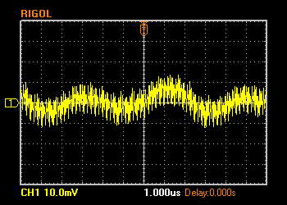
Input Voltage Ripple Measurements (cont.)
V_{IN} Ripple voltage
(V_{IN}=5V, V_{OUT}=1.8V, C_{IN}=4.7uF + 0.1uF, I_{OUT}=0A, Forced PWM Mode)
V_{IN} 10mV/Div. (AC)

Slide 22
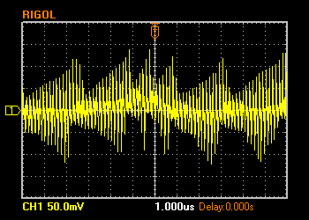
Input Voltage Ripple Measurements (cont.)
V_{IN} Ripple voltage
(V_{IN}=5V, V_{OUT}=1.8V, C_{IN}=4.7uF + 0.1uF, I_{OUT}=1A, Forced PWM Mode)
V_{IN} 50mV/Div. (AC)

